Slide 1



EcoVision
"See waste. Know its impact."
An AI-powered web application for waste classification using Deep Learning & Computer Vision
By: Sahil Sharma

Slide 2
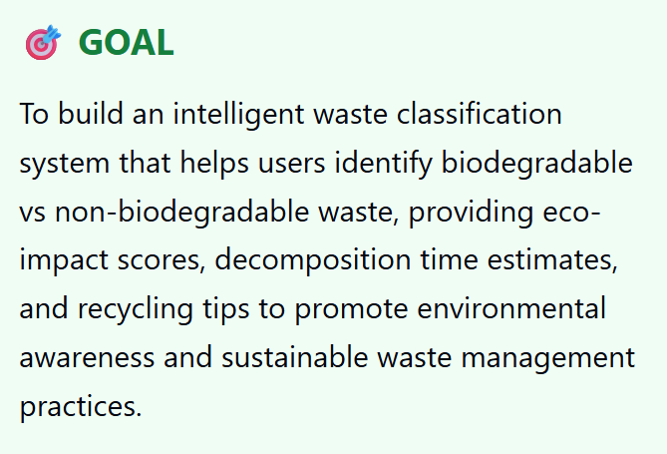
Learning Objectives
✓Apply transfer learning using MobileNetV2 for image classification
✓Develop a full-stack AI application with Flask backend and responsive frontend
✓Implement image preprocessing and model inference pipeline
✓Create RESTful APIs for ML model deployment
Source :
www.freepik.com/

Slide 3
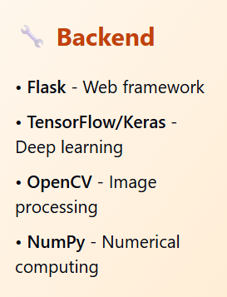
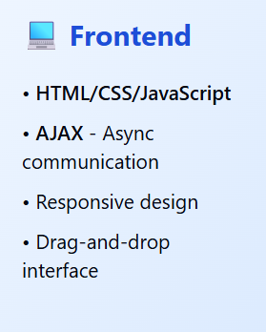
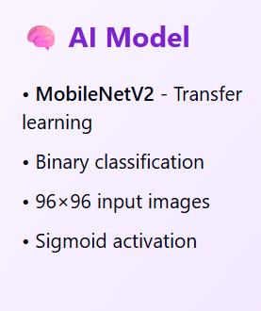
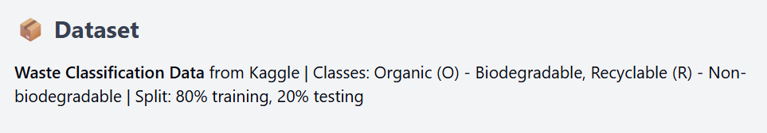
Tools and Technology used

Slide 4
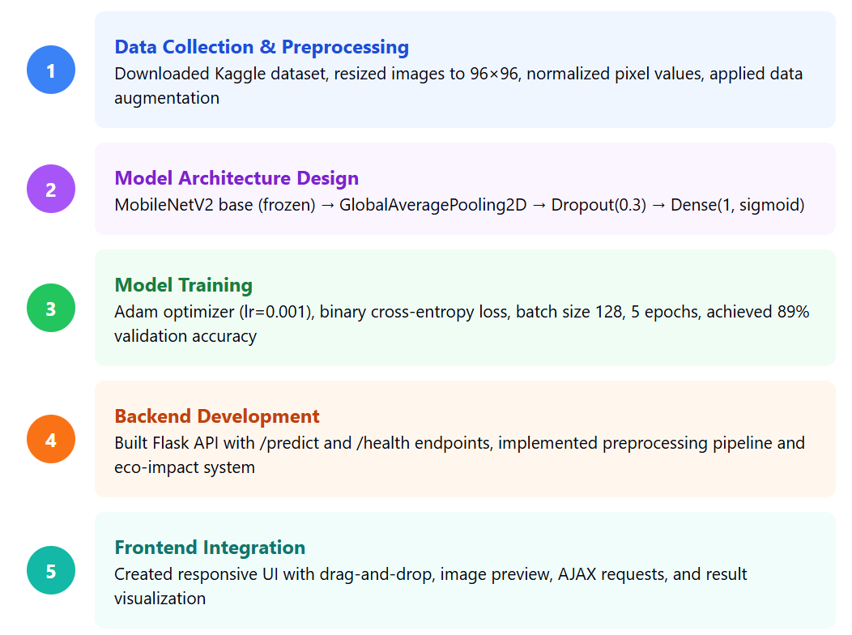
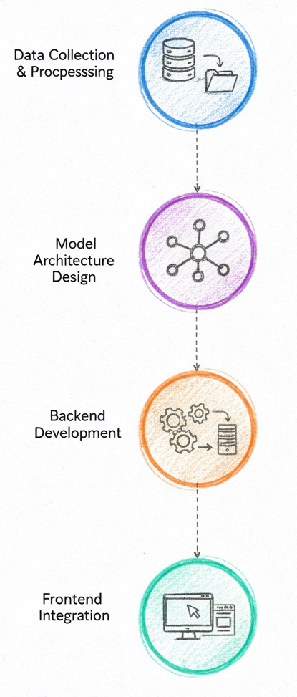
Methodology

Slide 5
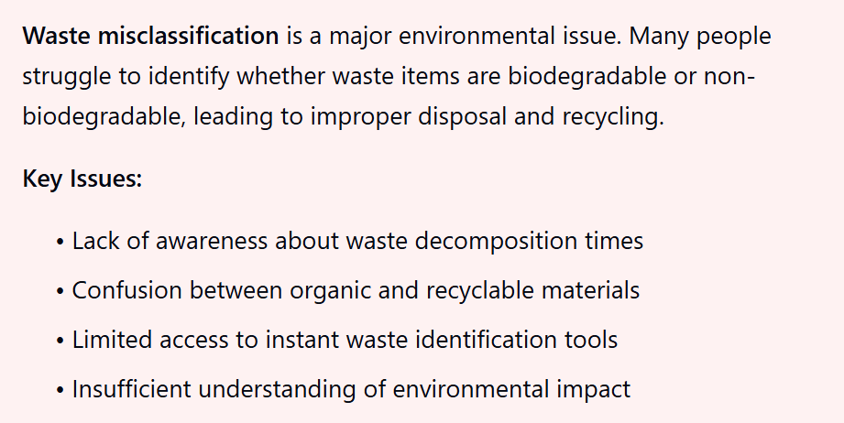
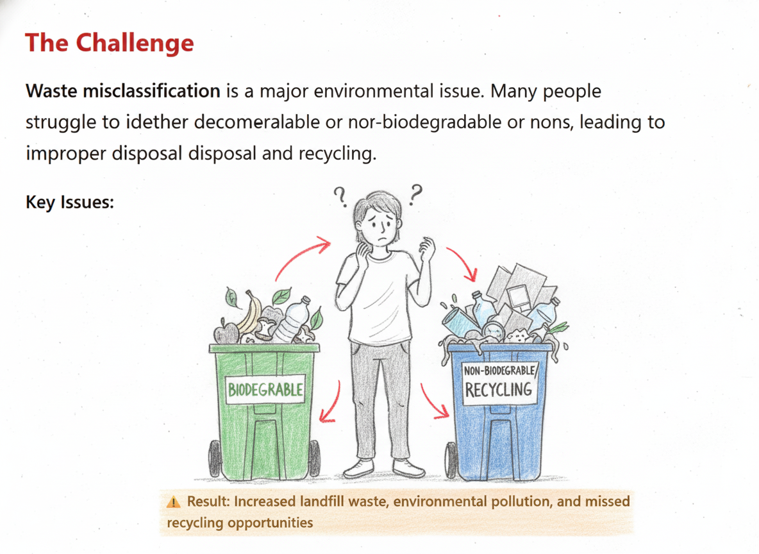
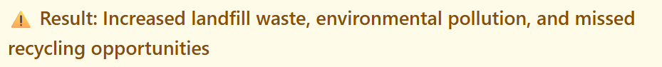
Problem Statement:

Slide 6
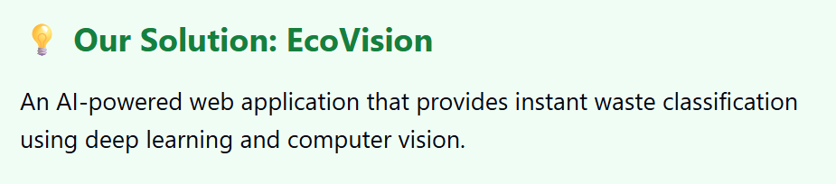
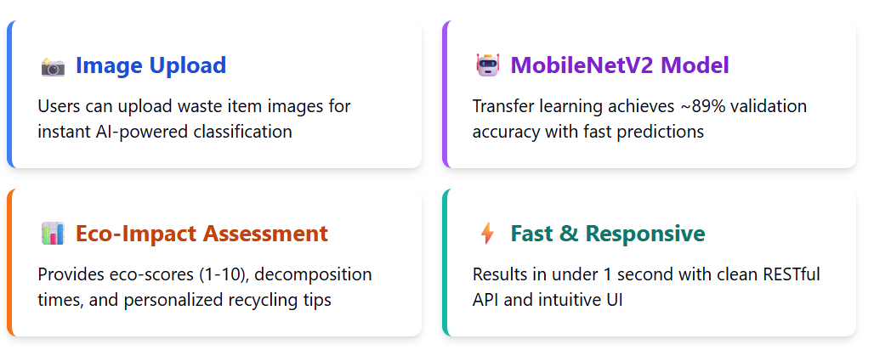

Slide 7
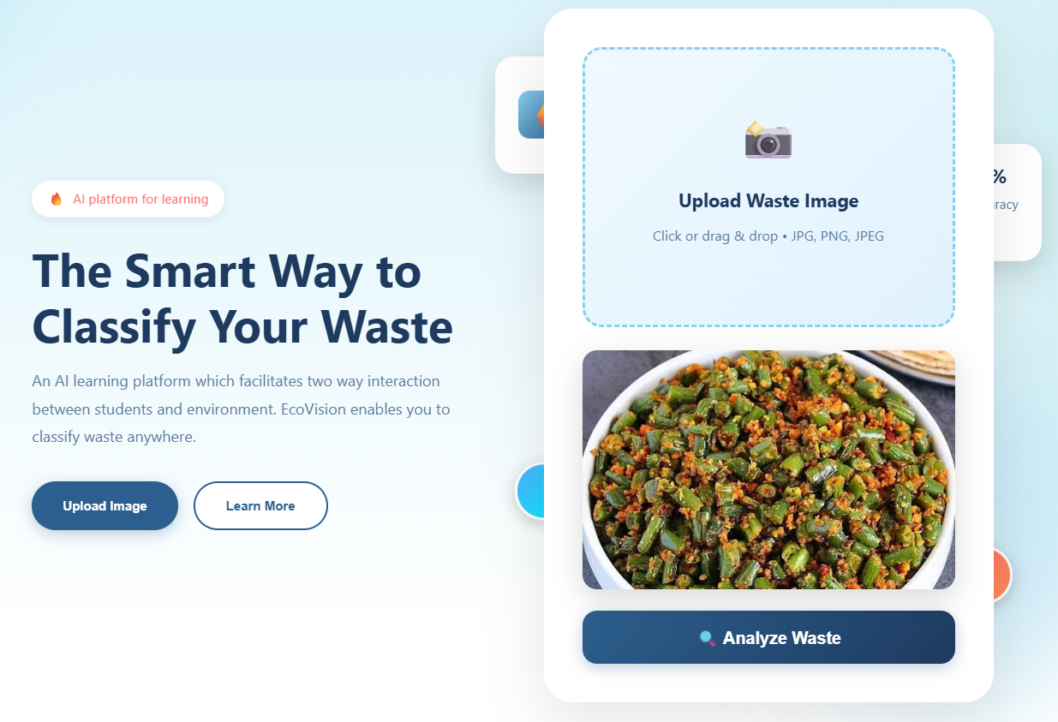
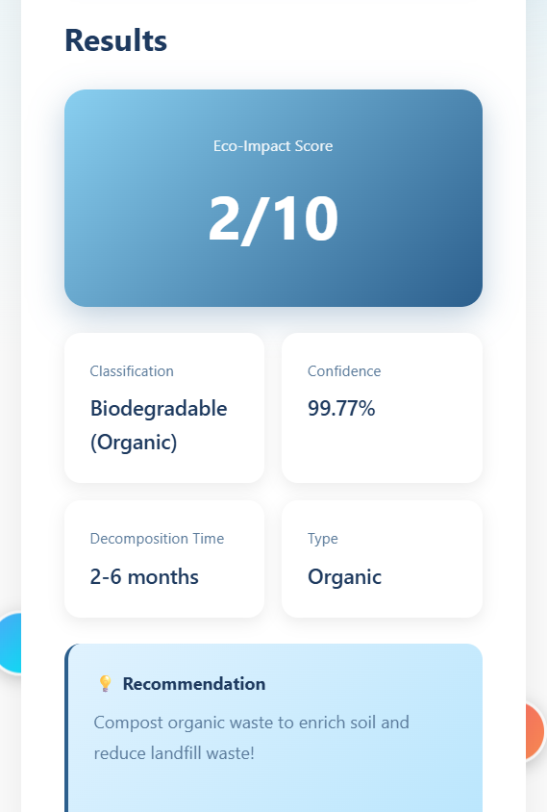
Screenshot of Output:

Slide 8
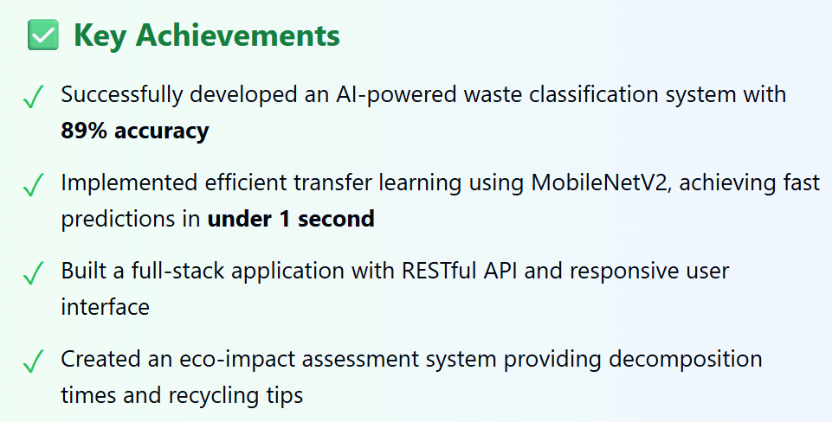
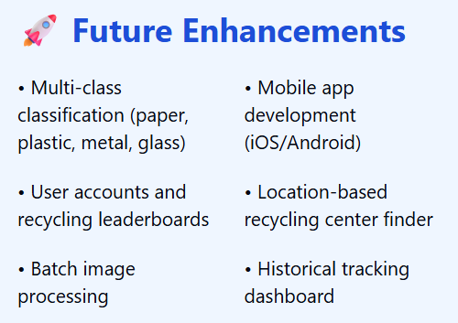
Conclusion:

